Slide 1
The simultaneous revolutions
Egypt/ Suez Crisis
Pan Arab Nationalism
Suez Canal takeover
British/French/ Israeli Invasion
US policy of “Containment” at risk in Middle East
Hungarian Revolution
Hungarian nationalism
Soviet retreat
Radical pro west regime request for help
Should US take this opportunity to go beyond “Containment”?

Slide 2
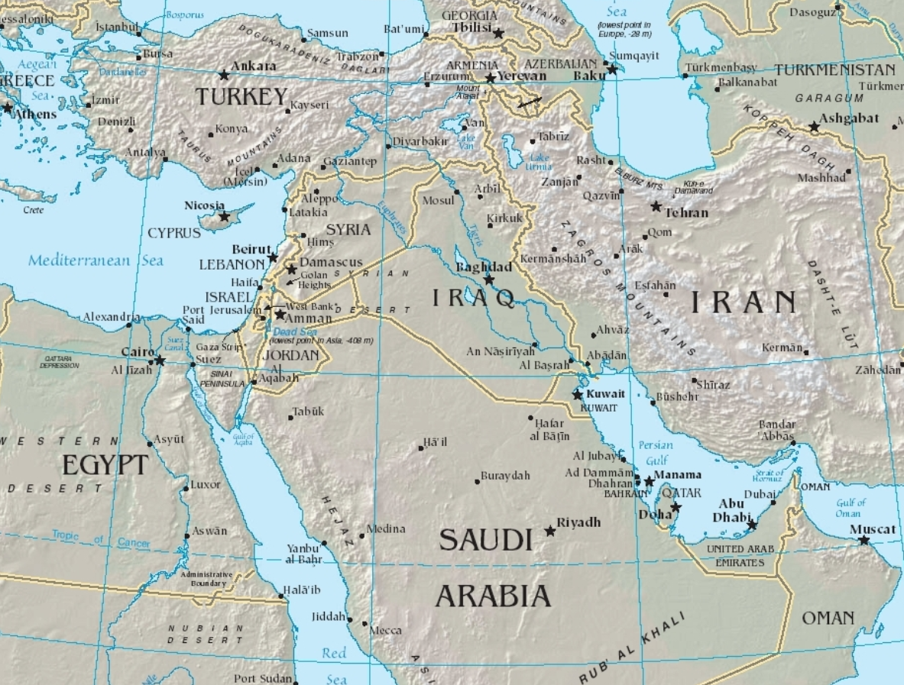
Egypt Suez Canal
About Canal
…Built 1869 by French/ finance Britain
...80% Trade British to India
…Seized by Britain 1883..recover debt
…1930-1950..prime route oil shipments
Britain and Egypt
…Egypt bankrupt
…Britain invades 1882
... Egypt a “Protectorate”
Suez Canal
Anglo Egypt Treaty 1936
..Egypt to be “independent” 1952
..Britain to occupy & run canal 1956
..Remove army 1956/ keep ownership
..Install “puppet” King Farooq

Slide 3
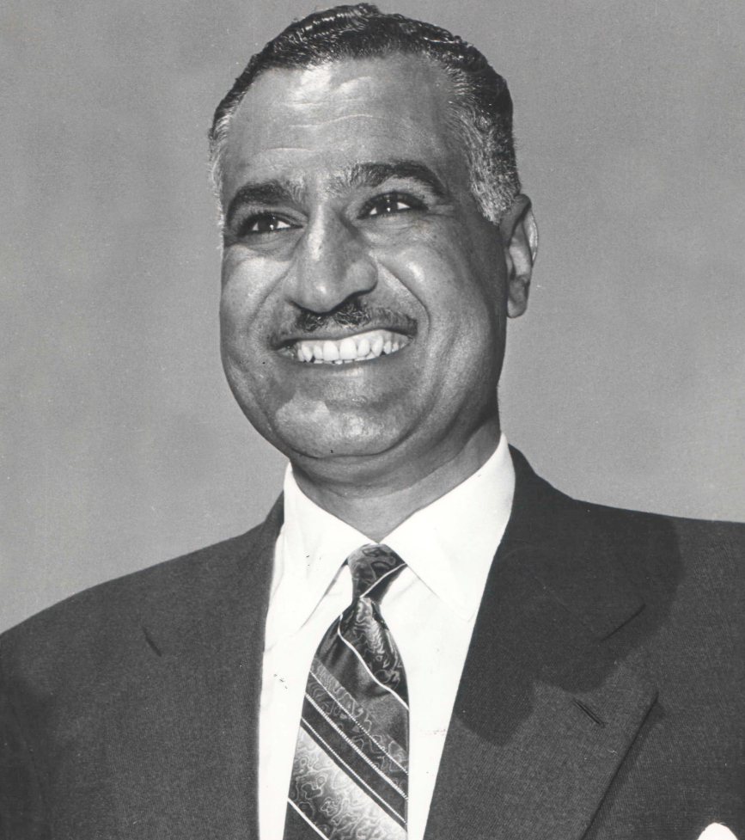
Abdul Nasser (1918-1970)
Working class background. Army officer
Arab Nationalist
…anti colonialist
…modernise & unite Arabs
…Incensed by creation of Israel
Leads coup 1952
…Policy of “Non Alignment”
…Modernize & Secularise Egypt
...opposes Muslim Fundamentalists
...Build Aswan Dam/ US to finance
Nationalizes Dam 1956…British army gone
…Radio broadcasts Arabs to unite…resist colonisation
..US cancels loan
..Nasser secures loan from USSR

Slide 4
The Suez Crisis
US response
“Non alignment” unacceptable: USSR loan = Nasser Communist
Need to retain influence Arab nations to secure oil
Middle East “British problem”…delegate solution to Britain
British/ French/ Israel
British humiliated, threat to oil supply, investments
France: pan Arabism a threat to Algerian colony
Israel: Nasser sending is uniting Arabs and dangerous and should be removed
British/ French/Israel decide to invade & remove Nasser
….without informing US

Slide 5
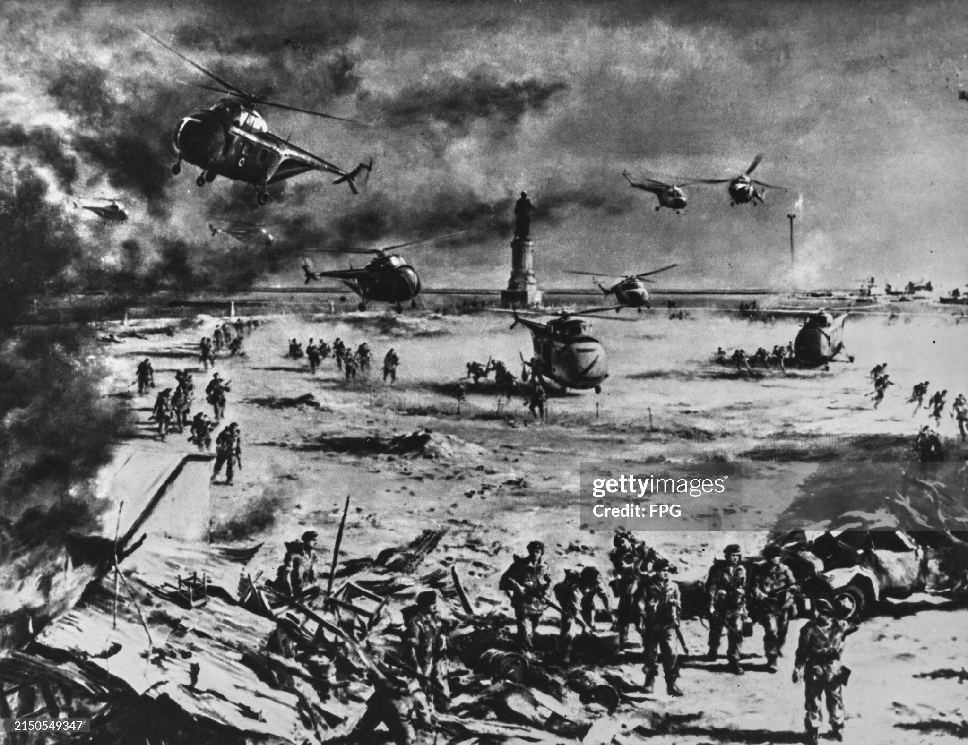
Invasion
British/ French. Israeli deal
…Israel to “invade” Egypt
…Britain/ France to rescue
British and French landings October 29th
Operation complete November 4th …1,000 civilians killed
...Egyptian army crushed
USSR threats:
…missile attack on Britain
…occupation of Berlin
USA incensed
…Britain “gone mad”
USSR sends army to crush revolt
In Hungary November 4th

Slide 6
…………..Meanwhile in Hungary

Slide 7
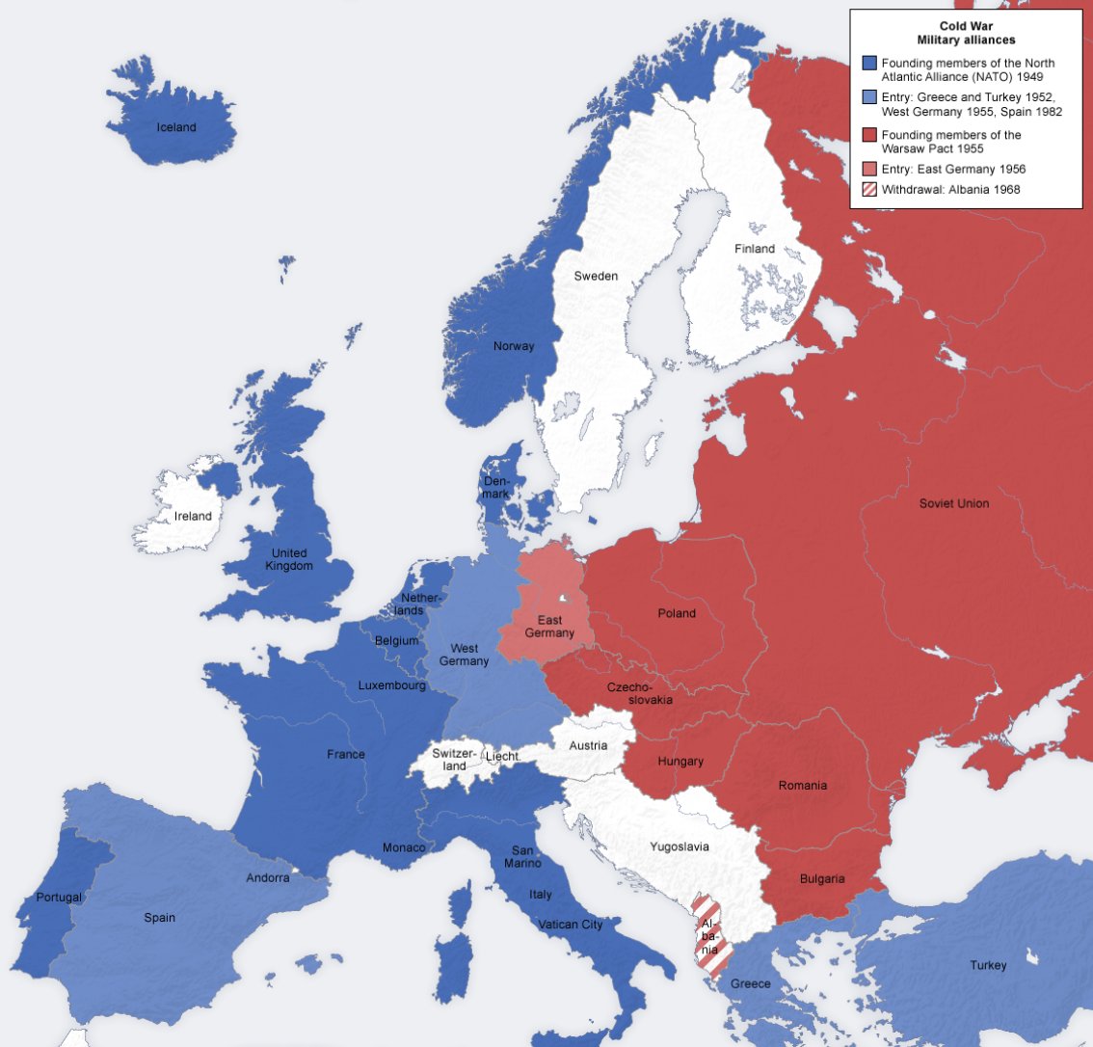
Hungary 1945-1956
German Ally during WW2
“Liberated by USSR 1945
Stalin regime 1945-1954
…One party state
….Opposition in prison/shot
Death of Stalin 1952
,,,Moderate regime
…Advocate reforms
...Mass revolts

Slide 8
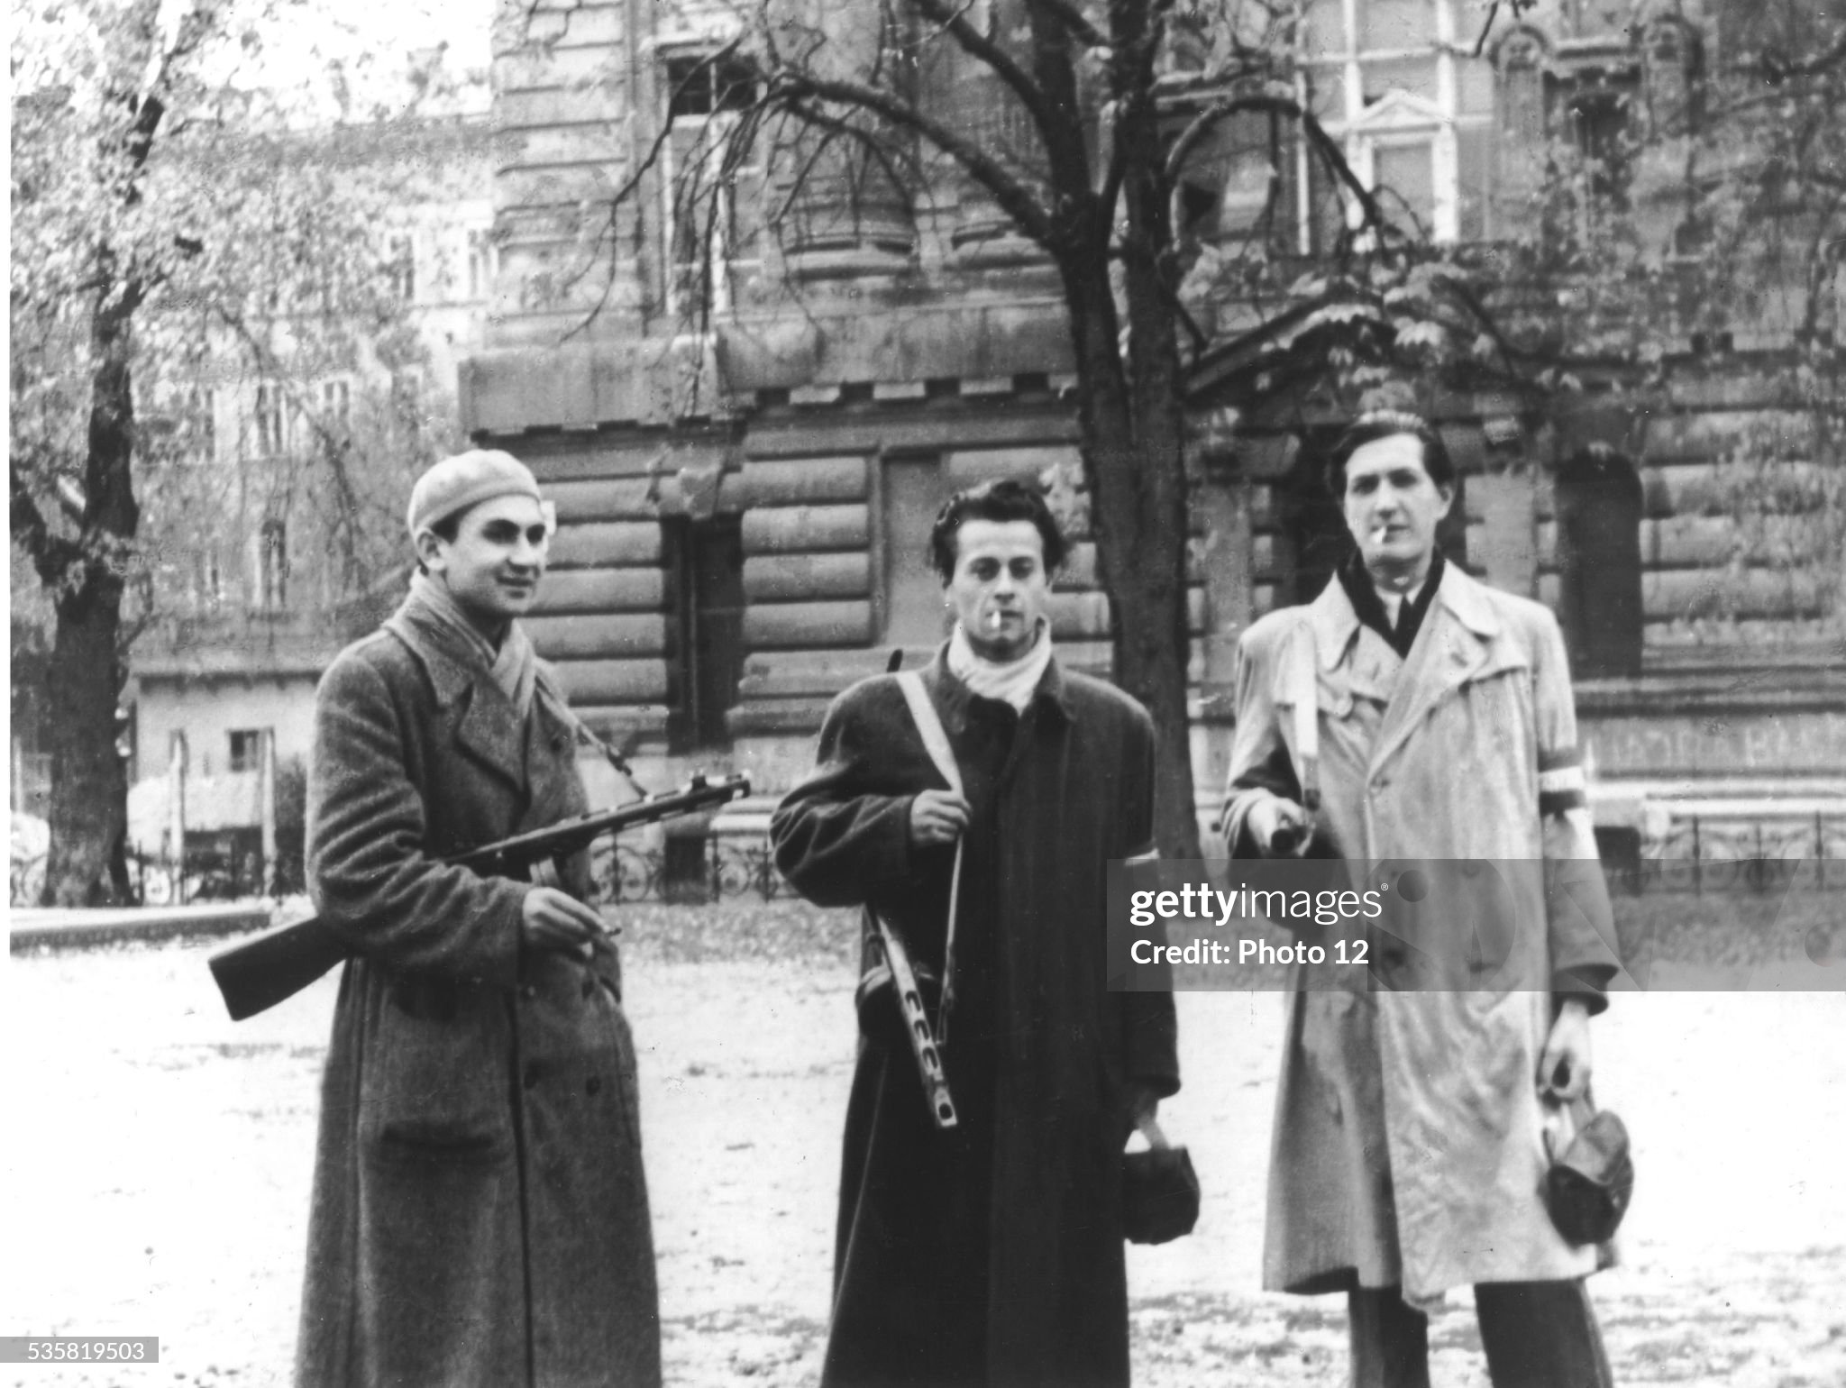
Hungarian Revolution October-November 1956
‘Democrats2 seize power
…leave Warsaw Pact
…eject Russian garrison
..open prisons
…demand elections
USSR: power vacuum
….indecisive
..offer to negotiate
Khrushchev. Change in policy
…arrest/ prison/shoot Hungarian
Negotiators/ sends in army
Rebels beg US for help

Slide 9
US Response to “events” of 56
Suez/ Egypt: Instruct British and French to withdraw/ stop loans
Britain humiliated…..PM resigns, finished as major power
France…US not a reliable ally…commits to French nuclear programme
Nasser emboldened….Arab hero….nationalist but no communist
Lebanon crisis 1958…pro West government threatened, US sends marines
Hungary…non intervention
2,000 killed by Russian troops (700 Russians)
Radical leaders arrested –350 shot, 100,000 imprisoned
2 million Hungarian refugees to Austria
Khrushchev position secured.
No risings in Eastern Europe till 1968

Slide 10
…meanwhile “Containment” under threat closer to home….Cuba

Slide 11
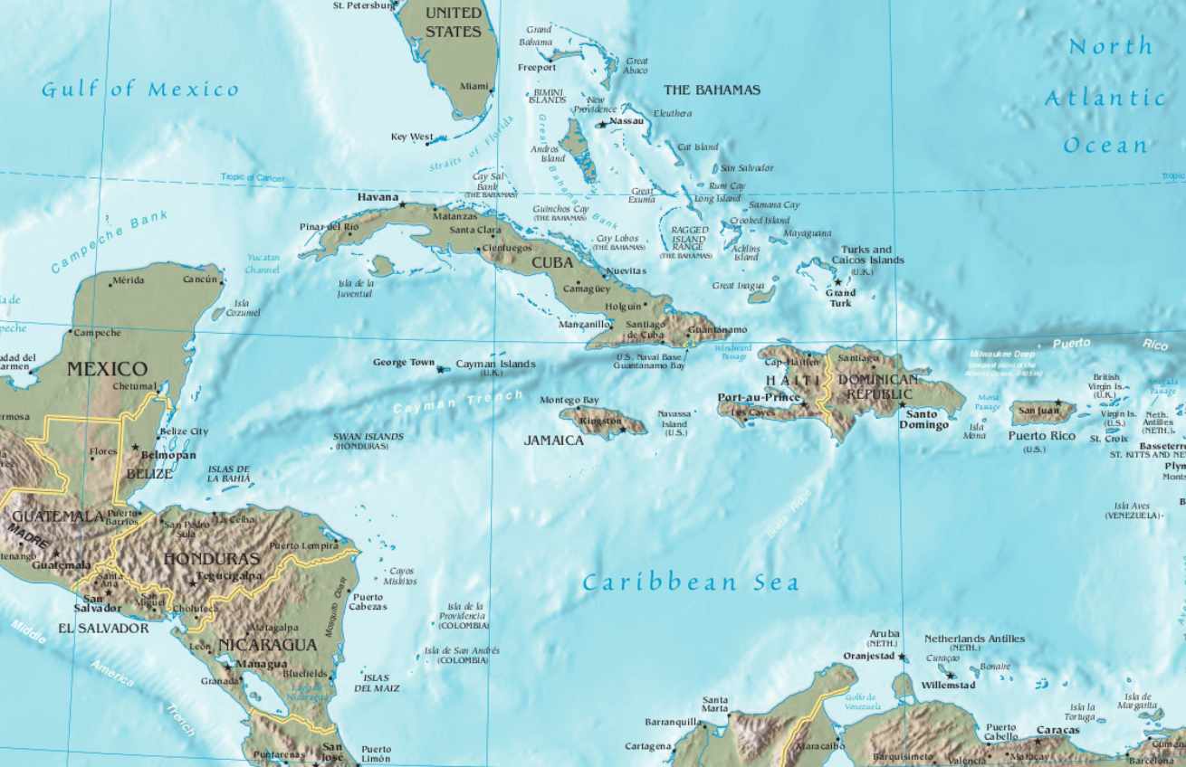
Cuba 90 miles from Florida

Slide 12
Cuba and USA
Cuba Spanish colony 1519-1898
US invasion1898-1902
Platt Amendment…retain “right to intervene” if US interest
Re-invade 1906-1909 and 1912
Military dictatorships/ upper class elites funded by US
Cuba 1950
GDP per capita above Latin America, 10% of USA ($2,200 vs $23,000 in 1950$)
Mixed race 70% “White” 20% black, 10% mixed race
Economy: sugar, tobacco and tourism
High level of inequality /large middle class/ foreign ownership
Upper class 2%, Middle class 25%,Workers and peasants 73%%
To the US Cuba a source of business….and playground

Slide 13
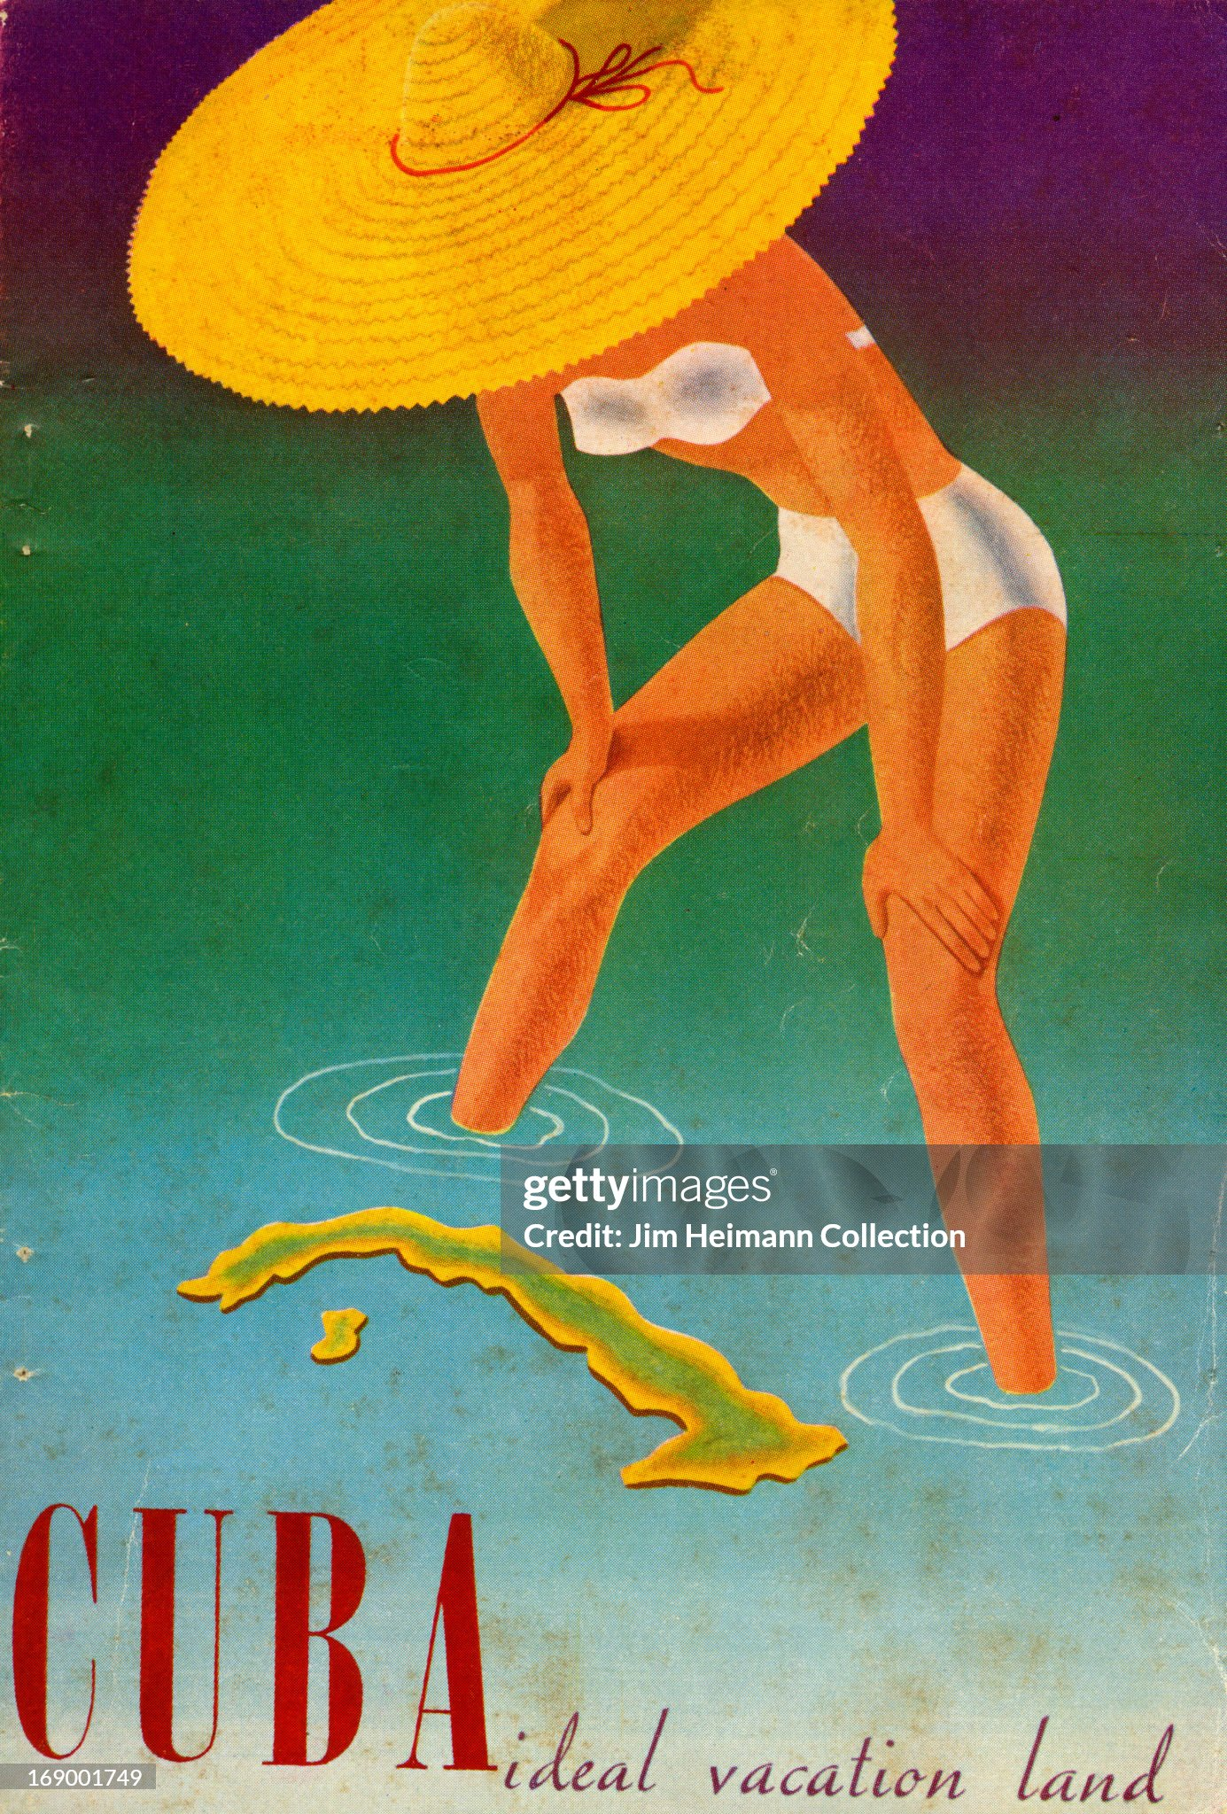
Cuba: $40-$100 for weeks holiday from US in 1950’s

Slide 14
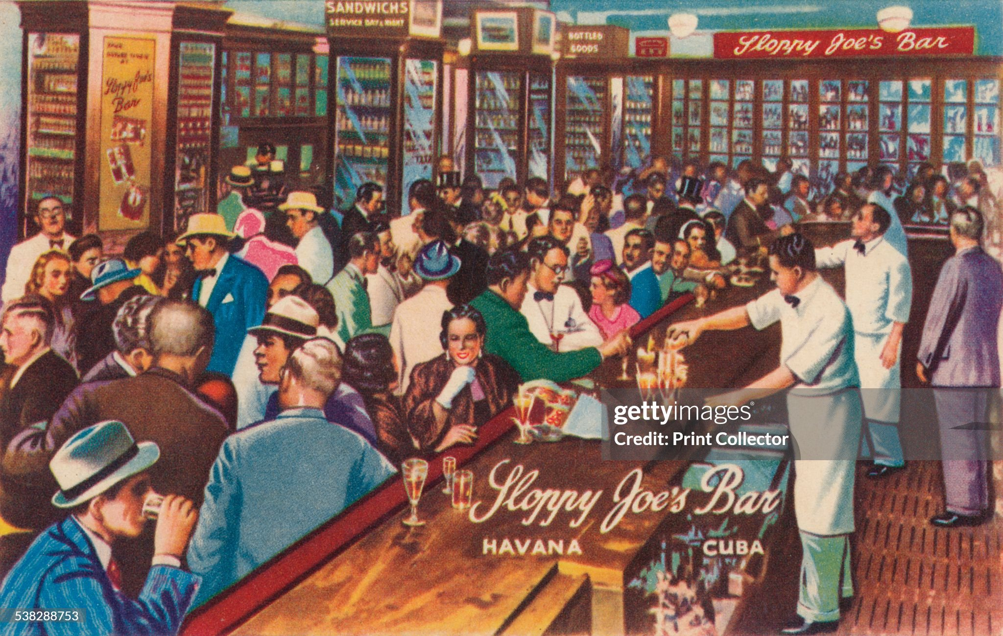
Havana: mecca for organized crime …”Sloppy Joe’s Bar”…Mafia money laundering ….multiple Casino…Las Vegas on water

Slide 15
A Colonial Economy
US economic dominance
90% Cuban mines nickel, copper, zinc)
80% Public utilities/ 50% Railroads40% Sugar factories
40% Cuban land US owned
Wealth retained by US English speaking elite (2% owned 60% nation’s wealth)
Racial segregation black’s illiterate, segregated,
Culture of humiliation and oppression “ Daily life had developed into a relentless degradation," writes Louis Perez in his 1999 book On Becoming Cuban, "with the complicity of political leaders and public officials who operated at the behest of American interests.". Louis Perez “On Becoming Cuban” 1999

Slide 16
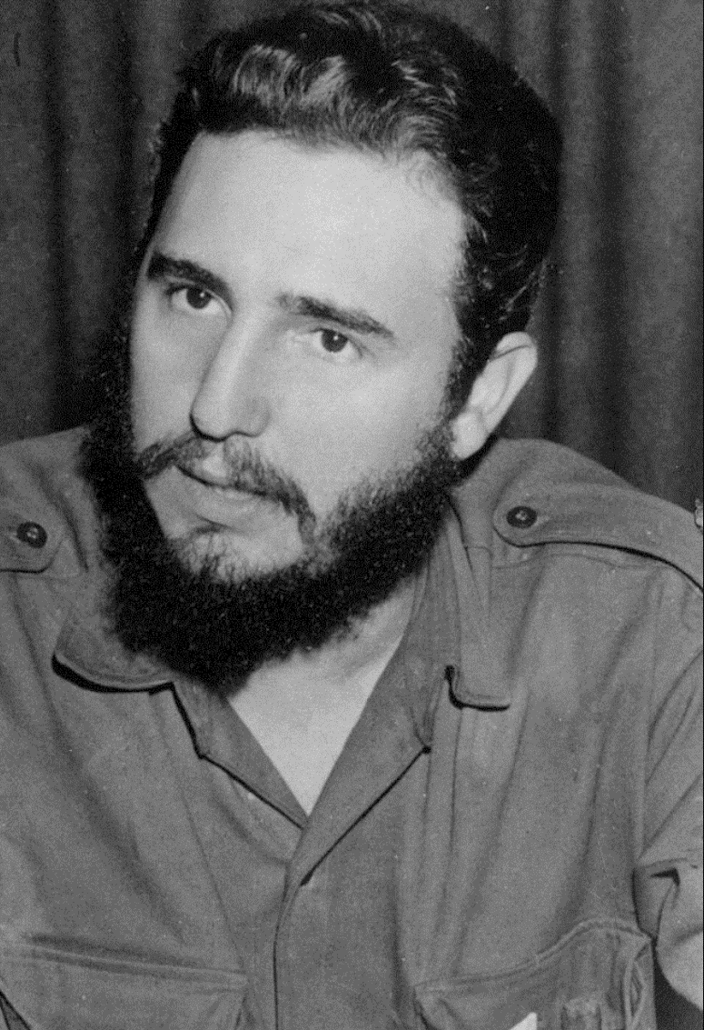
Cuban Revolution 1952-1959 January 1
Fidel Castro 1926-2011
From wealthy 2%
…visited US. Try out for baseball
Lawyer/ journalist…nationalist
Leads coalition of revolutionaries
..not Communist…advisors (Raul)
…Che Guevara are
Establishes guerrilla army (2,000)
Controls Radio….charismatic
Other revolts across Cuba unite
…accept Castro leadership
National army of 200,000
Collapses…joins Castro
Occupies Havana, Batista
Flees….with cash

Slide 17
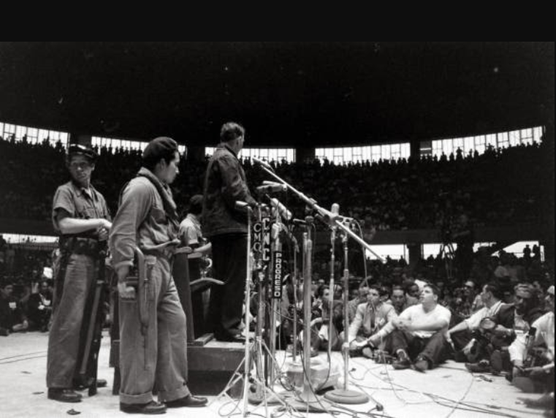
“Revolutionary Justice” ….Public trials…3 judges…1000’s shot … Regime had killed 20,000 Cubans to retain power ...

Slide 18
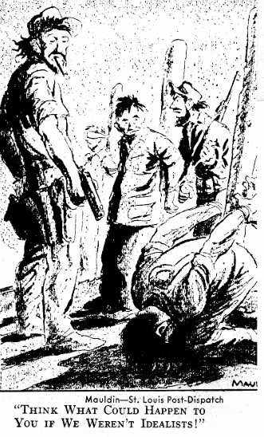
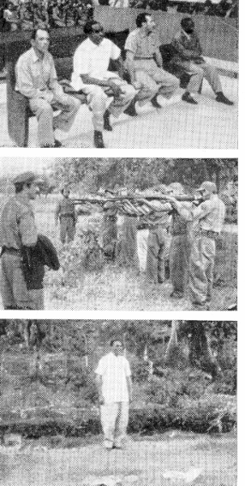
…The Perils of losing in Latin America

Slide 19
US Response
Batista discredited by corruption….links to organized crime
Castro claims to be nationalist….not Communist
Influenced by brother Raul and Che Guevara (Argentine)
US dilemma: another military dictator or revolutionary
Eliminate….lose “leader of free world” role, alienate growing Non Aligned Group
Support… US business/ influence at risk
Eisenhower invites Castro to visit US

Slide 20
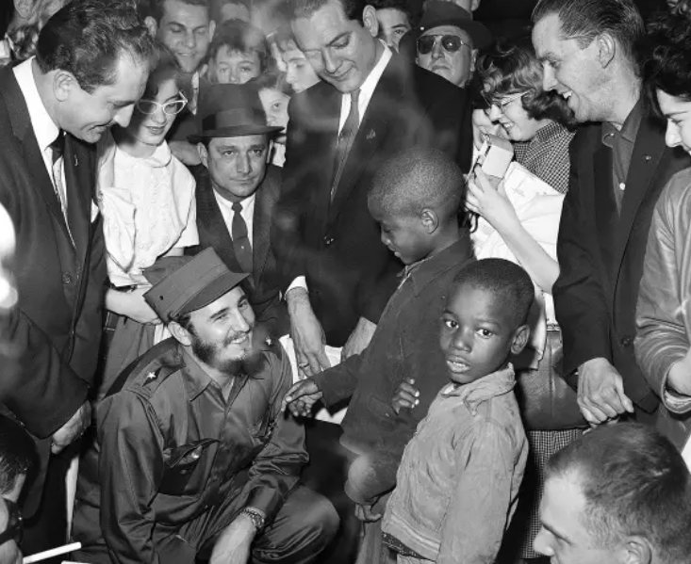
Media star….mixes with public

Slide 21
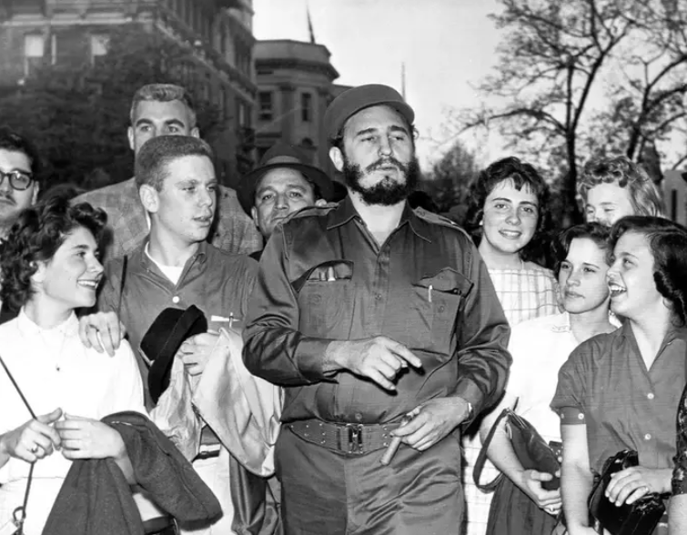
With students Missouri. Popular everywhere

Slide 22
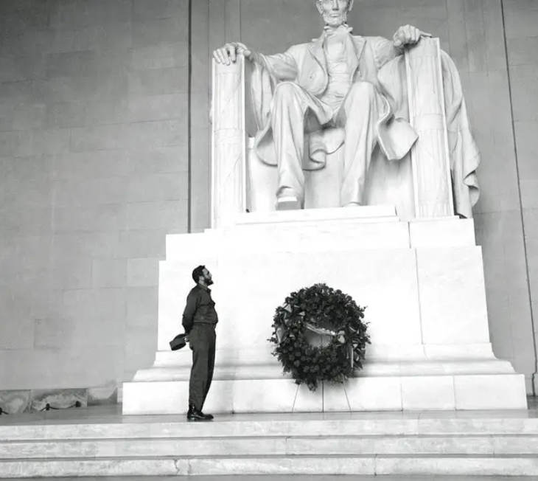
Viewing Lincoln Memorial

Slide 23
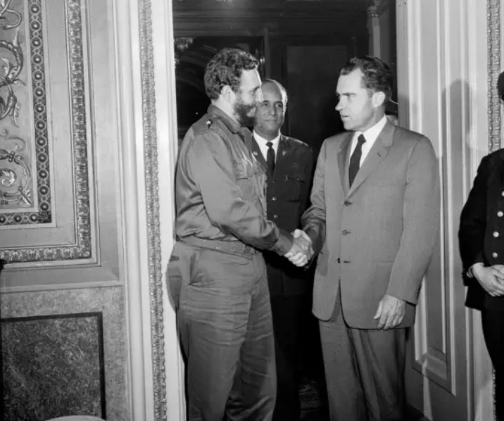
Meets Nixon…. (Vice President) …Eisenhower will not meet ….Nixon convinced Castro communist

Slide 24
Castro in power 1960-1962
Land Reform: land seized, distributed to peasant
“partial” compensation to US business/ land owners…bonds
Nationalises Industry…large firms nationalised, US business to Cubans
Labour reforms….minimum wage, salary raises for poor, reductions professionals
Expropriation of most private business
Middle class impoverished
Abolishes discrimination/ literacy programme/ health care
Political parties and elections abolished/ opponents exiled or shot
USSR replaces US …oil, food, armaments/ Castro's announces he is Communist

Slide 25
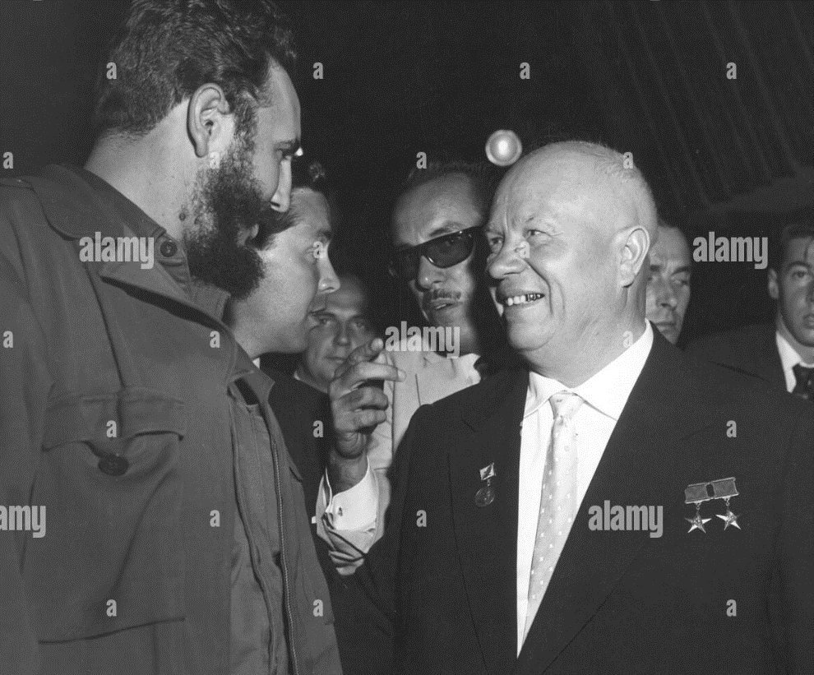
Castro to Moscow 1961

Slide 26
Cuban Revolution Impact
Eisenhower Administration determine to “get rid of Castro”
Pass Cuban Claims Act….demand full compensation
Trade Embargo
CIA assassination plots : Operation Mongoose
Exodus of Cuban middle class
250,000 1960-1961, 2 million refugees by 1970..400,000 plus in Florida
Florida becomes base for Republican …”Hard Right”
Cold War intensified:
Russian proxy active in West
USSR emboldened…threats to Berlin

Slide 27
US and Cold War 1960

Slide 28
Arms Race 1950-1960
Nuclear warheads atomic & thermo nuclear
( from Chat GBT…numbers secret till 1990’s)
 | USA | USSR | UK
1950 | 50 | 5 | 0
1955 | 1,000 | 200 | 45
1960 | 18,000 | 1,600 | 125
French systems still under development
US has vast superiority
….and missiles/ aircraft deployed in Turkey, Italy, NL, Belgium
USSR has sufficient forces to annihilate USA
….maintain high security to conceal disparity
What matters…..perception

Slide 29
Sputnik 1958 …US suddenly vulnerable …..US media…USSR superior!

Slide 30
Missile Gap Controversy
Gaither Report 1957
USSR technology superior and increasing
100’s Intercontinental Missiles deployed
US neglecting defence and must increase 5
Report leaked to public 1958: Eisenhower Admin on defensive
Eisenhower Response
Commissions Air force investigation
Spy planes to fly over USSR (U2)…too high for Russian missiles.
Agrees summit meeting with Khrushchev to establish arms control

Slide 31
U2 Incident
U2 / Investigation reveals Gaither Report grossly overestimate USSR
USSR shoots down U-2 & captures pilot during Summit Meeting
Eisenhower denies flights taking place
Khrushchev introduces pilot to public
Summit collapses….no agreement on Arms Control
1960: New Decade, New Time
…..time for someone new

Slide 32
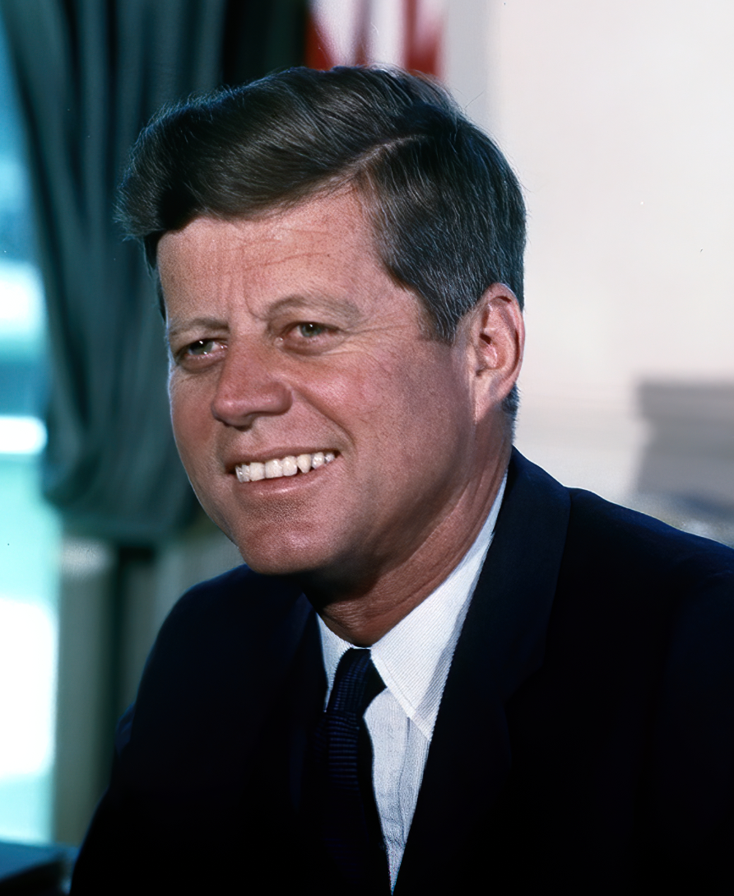
Enter John F Kennedy

Slide 33
Next talk: “Camelot”…the life and Presidency of John Kennedy April 7th, the Chancery 10:00 AM

